Slide 1


micro:bit robot entry tutorial
Lesson 11
micro:bit advanced lesson 11 “Infrared control”
YahBoom micro:bit video tutorial

Slide 2
micro:bit robot entry tutorial
Content
Part1
Part 2
Part3
Part 4
Part 5
Learning goals
Preparation
Search for blocks
Combine blocks
Attentions
YahBoom micro:bit video tutorial

Slide 3
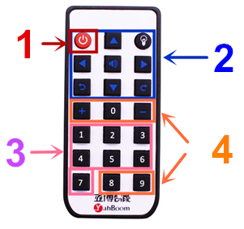
micro:bit robot entry tutorial
Part 1
After you download the program, you can control the car by remote control.
Press the button in the box 1 to turn off the light.
Press the button in box 2, and you can light different colors of lights.
Press the buttons inside the box 3 can play different tones, and play a song for the score.
Press the buttons in the box 4 to display different patterns on the dot matrix.
Isn't it fun? Try it.
Learning goals
Tips:Do you wonder if the infrared indicator is not lit when the infrared remote control is used. Is this remote control a bad one? No, the infrared remote controller can't see the eye of the infrared light. You can open the camera of the mobile phone and look at the light of the remote control by the camera. When you press the button, it shows a slight flicker. Of course. Some phones have the function of filtering out the infrared light, which is also invisible.
YahBoom micro:bit video tutorial

Slide 4
micro:bit robot entry tutorial
Part 2
Hardware:
● 1 X BBC micro:bit
● 1 X micro:bit expansion board
● 1 X USB cable
● 1 X Infrared controller
Preparation
Then the micro:bit is connected to the computer through USB, and the computer will pop up a U disk and click the URL in the U disk to enter the programming interface. Input this URL https://github.com/lzty634158/yahboom_mbit_en and https://github.com/YahboomTechnology/Yahboom_IR to get the package.
YahBoom micro:bit video tutorial

Slide 5
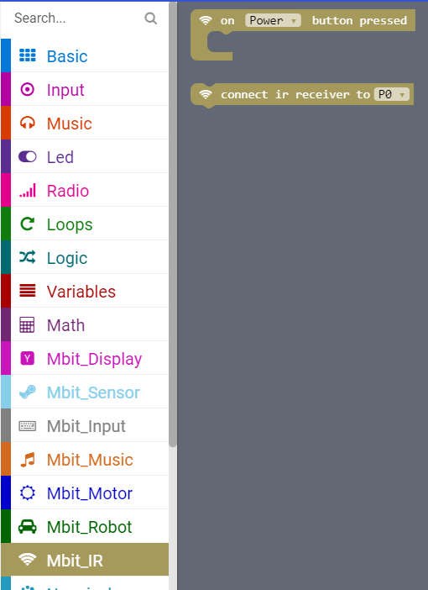
micro:bit robot entry tutorial
Part 2
Search for blocks
YahBoom micro:bit video tutorial

Slide 6
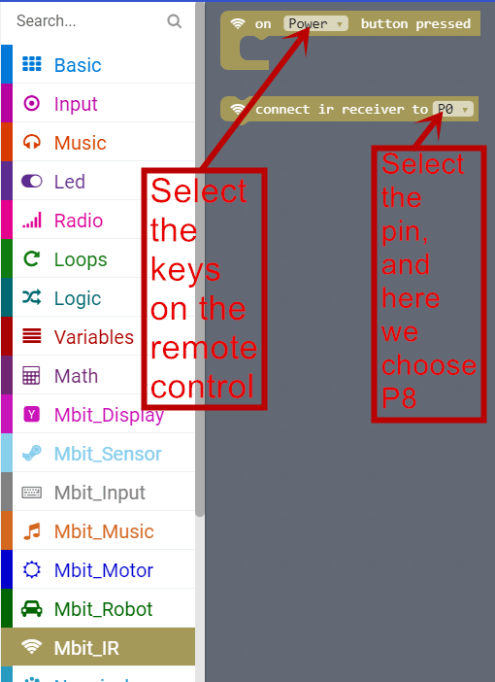
micro:bit robot entry tutorial
Part 3
Search for blocks
YahBoom micro:bit video tutorial

Slide 7
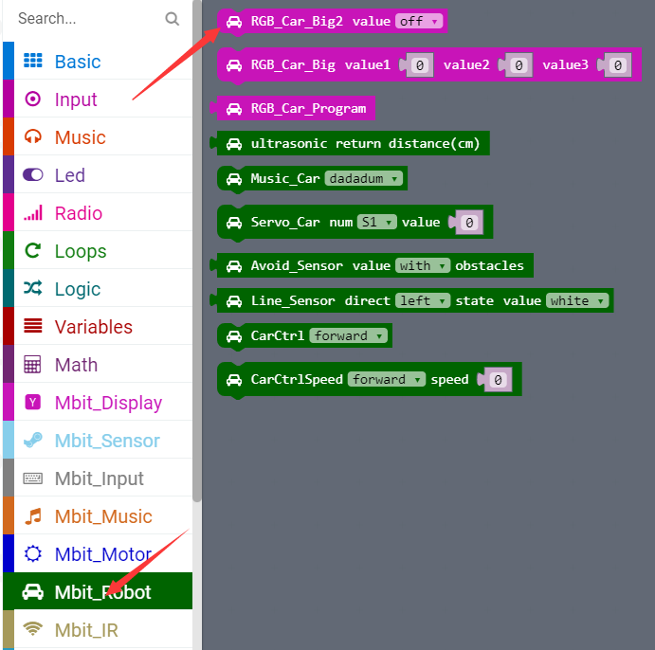
micro:bit robot entry tutorial
Part 3
Search for blocks
YahBoom micro:bit video tutorial

Slide 8
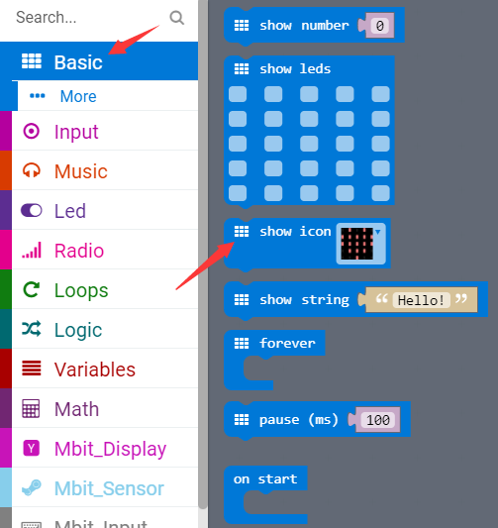
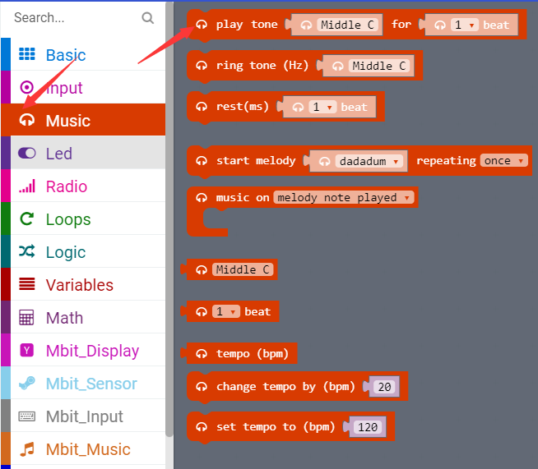
micro:bit robot entry tutorial
Part 3
Search for blocks
YahBoom micro:bit video tutorial

Slide 9
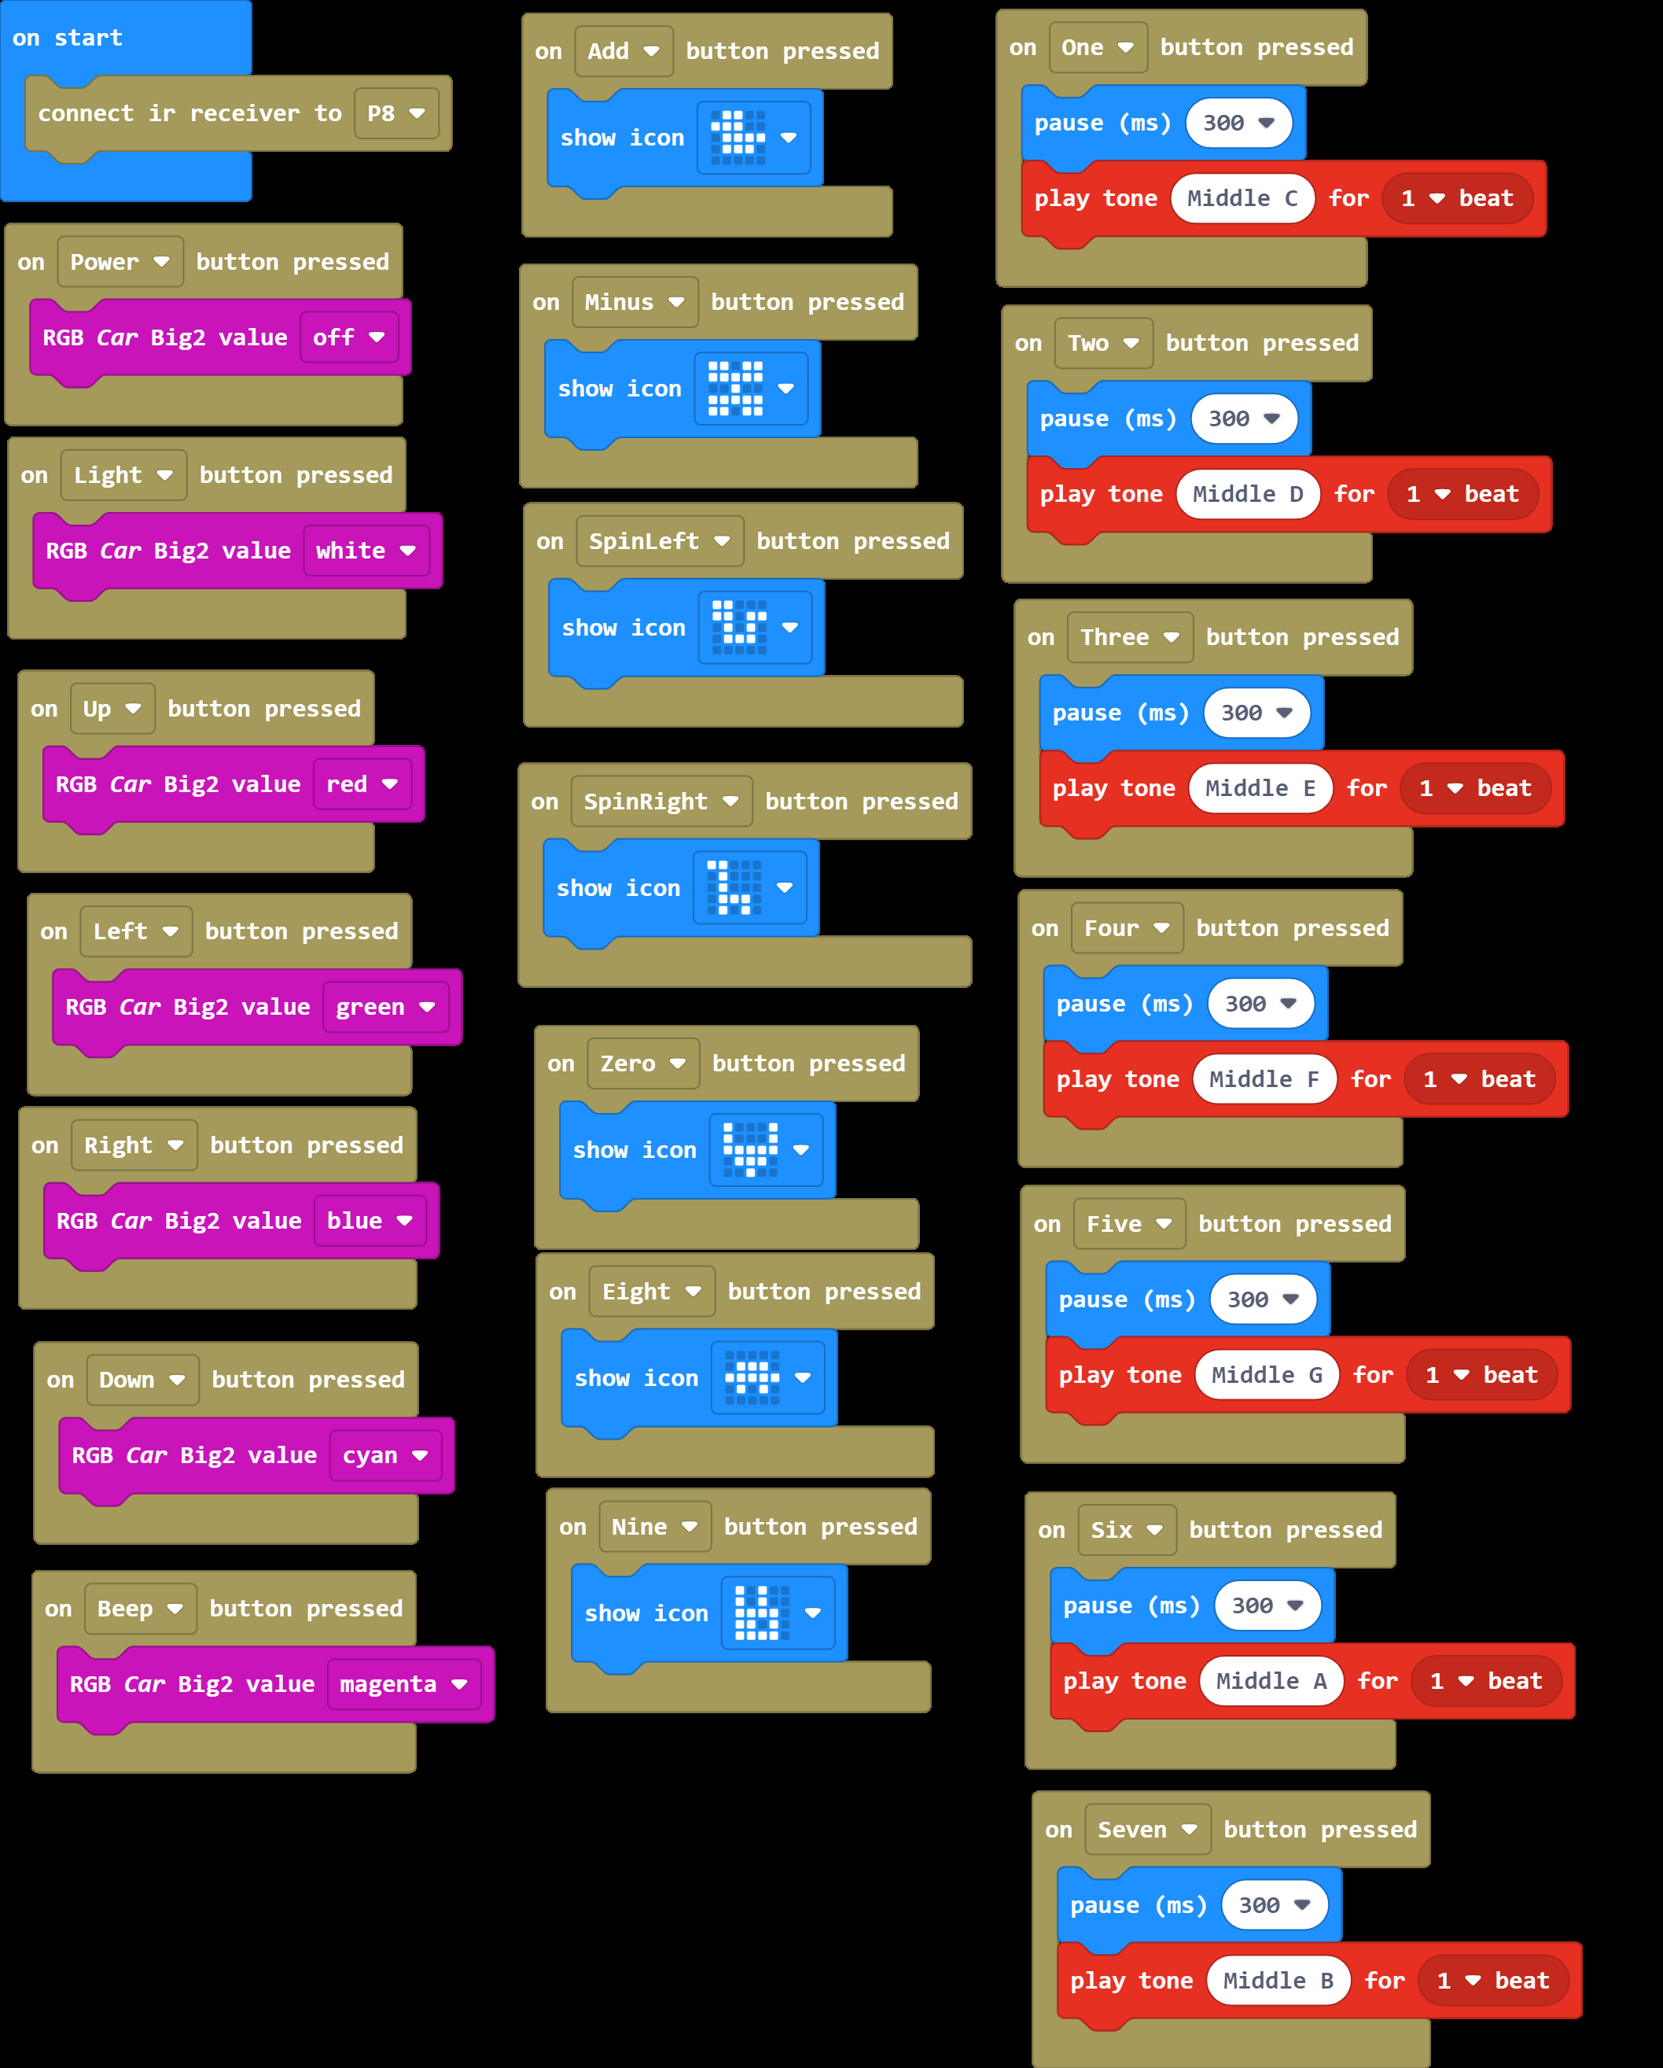
micro:bit robot entry tutorial
Part 4
Combine blocks
YahBoom micro:bit video tutorial

Slide 10
micro:bit robot entry tutorial
Part 5
Attentions
This experiment must be carried out indoors to reduce interference from sunlight to infrared receiver.
YahBoom micro:bit video tutorial

Slide 11
micro:bit robot entry tutorial
robot
lesson
Thanks for watching！
Powered by YahBoom
YahBoom micro:bit video tutorial

